Slide 1
INSTALLING R/KNOWING R
May 2018
Bangalore

Slide 2
Installing R on Desktop/Laptop
What are R and CRAN?
➢ R is ‘GNU S’, a freely available language and environment for statistical computing and graphics which provides a wide
variety of statistical and graphical techniques:
• Linear and Non-linear modelling, statistical tests,
• Time series analysis, classification, clustering, etc.
➢ CRAN is a network of FTP and Web Servers around the world that store identical, up-to-date, versions of code and
documentation for R.
➢ Please use the CRAN mirror nearest to you to minimize network load.
………..

Slide 3
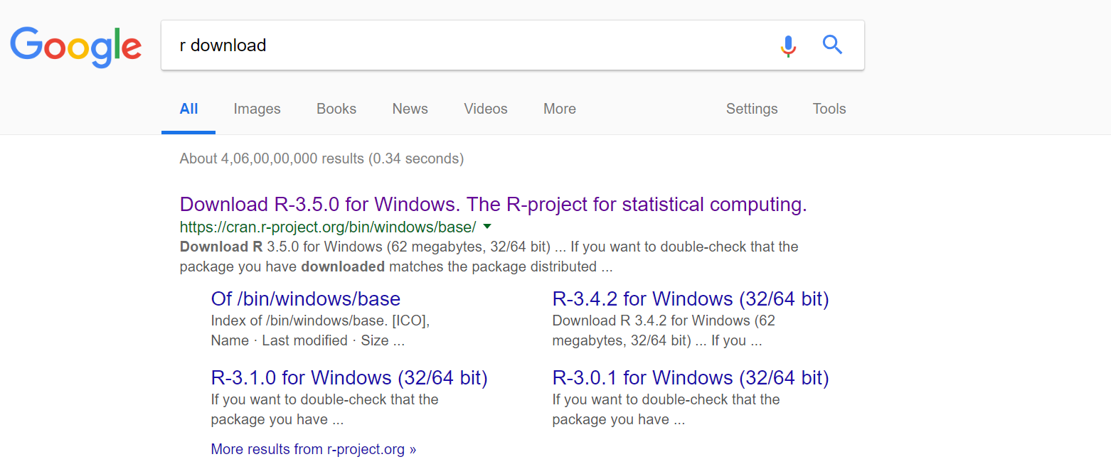
Installing R on Desktop/Laptop
Step 1 – Please type r cran/r download on Google Search.
Step 2 – Select first link
Step 3 – Select as per your OS
Step 4 – Select the following links as per the OS.
………..

Slide 4
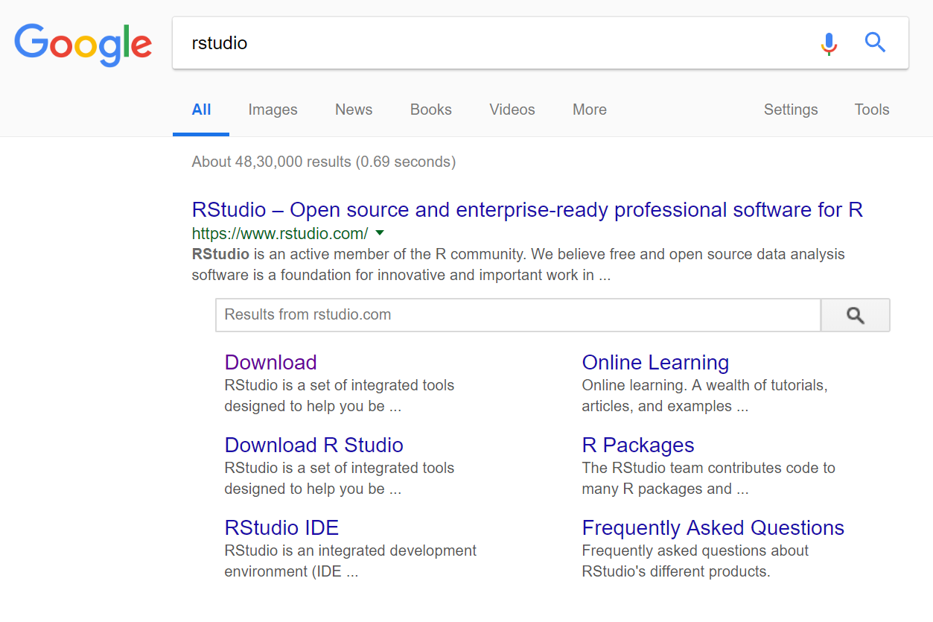
Installing R Studio
Step 1 – Please type r studio on Google Search.
Step 2 – Select first link
Step 3 – Click on “Download Rstudio”
Step 4 – Scroll down and select the appropriate installers based on OS. Install it after
download.
………..

Slide 5
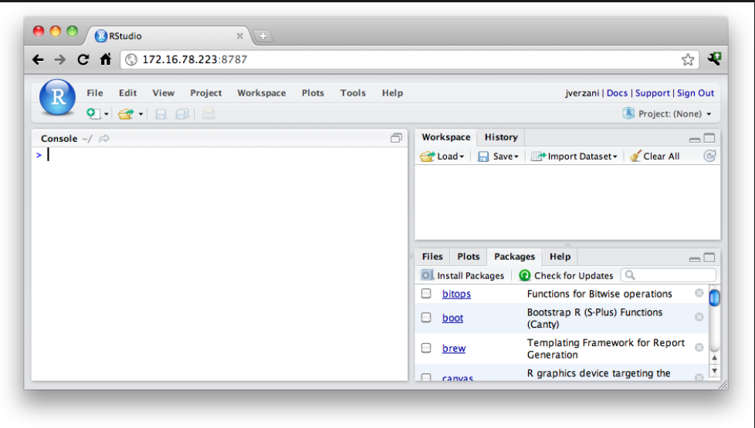
Knowing R Studio
There are four different Windows:
Data view, R Script Editor
2. Environment and History
3. Files, PPTs, Packages and Help
4. Console
………..

Slide 6
R List of Useful Packages
RODBC,RMySql - Read in data from a database, Choose the package
that fits your type of database.
XLConnect, xlsx - Read and write Microsoft Excel files from R. You
can also just export your spreadsheets from Excel
as .csv's
Foreign -Want to read a SAS data set into R? Or an SPSS
data set? Foreign provides functions that help you
load data files from other programs into R.
Dplyr - Essential shortcuts for subsetting, summarizing, rearranging, and joining
together data sets
Tidyr - Tools for changing the layout of your data sets. Use the gather and
spread functions to convert your data into the tidy format, the layout R
likes best.
Ggplot2-R's famous package for making beautiful graphics. ggplot2 lets you use
the grammar of graphics to build layered, customizable plots.
………..

